Slide 1
Computer Networks

Slide 2
Threaded Sockets

Slide 3
Where are we
Application Layer
HTTP/ HTTPS/ FTP/ SMTP
Transport Layer
TCP/ UDP
Network / Internet Layer
IP
Link Layer
Ethernet

Slide 4
Processes and Threads
Processes are made up of one or more threads.
A thread is defined as a single flow of operation within a program.
When a program executes on the CPU, it traverses the program statements in a single thread until the thread is complete.

Slide 5
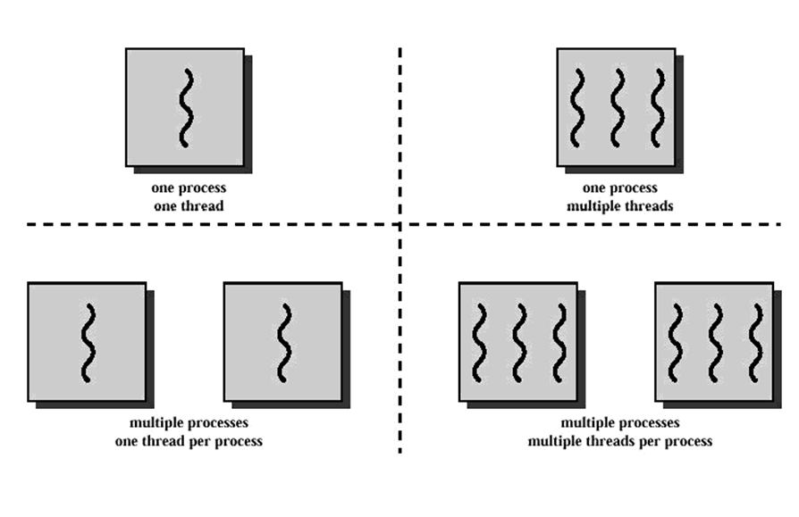
Notes:
Multi processes (client and server) and multi threads (each thread handle one client)

Slide 6
Using Threads
System.Threading namespace includes classes for creating and controlling threads within a program.
The ThreadStart delegate points to the method that will be performed within the new thread.
static void main()
{
Thread newThread = new Thread(new ThreadStart(newMethod));
newThread.Start();
. . . .
}
void newMethod()
{
. . .
}

Slide 7
Using Threads
If the function to be called needs a parameter we can use ParameterizedThreadStart delegate instead of ThreadStart delegate.
static void main()
{
Thread newThread = new Thread(new ParameterizedThreadStart (newMethod));
newThread.Start(“hi”);
. . . .
}
void newMethod(object obj)
{
// cast obj back to string
string str = (string) obj;
. . .
}

Slide 8
Using Threads
The newMethod parameter defines a method that is performed in the thread when it receives time slice on a processor.
In this example, the method was contained within the same class as the Thread object.
You can also run methods defined in other classes.
Thread object does not begin processing until the Start() method has been invoked.

Slide 9
Threads and sockets

Slide 10
Threaded Server
Threaded server splits off each client into its own world and deal with its data separately from the rest of the clients.
The key to the threaded server is to create the main server Socket object in the main program.
As each client connects to the server, the main program creates a separate Thread object to handle the connection.

Slide 11
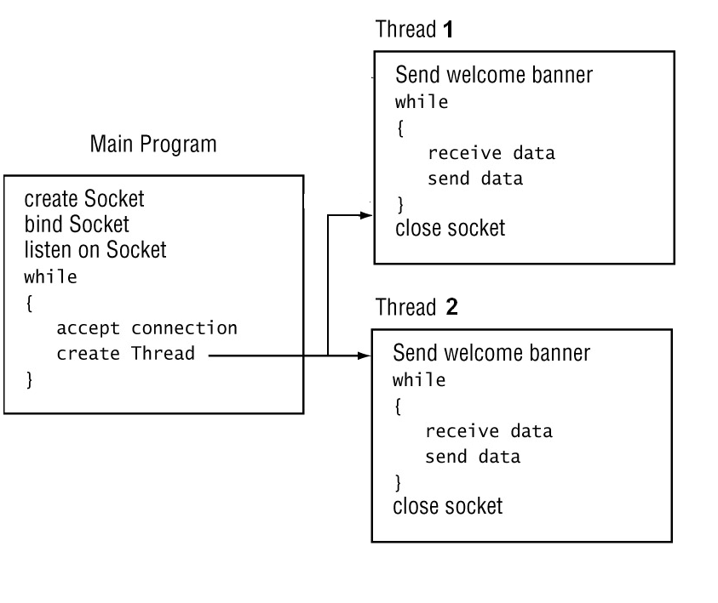
Server process

Slide 12
Threaded Server
By running separate threads, you can program your server to communicate simultaneously with many clients.

Slide 13
Example
//Server Members
private Socket serverSocket;
private int port;
public Server(int port)
{
this.port = port;
//Initialize serverSocket object and bind it to local host
serverSocket = new Socket(AddressFamily.InterNetwork, SocketType.Stream, ProtocolType.Tcp);
IPEndPoint hostEndPoint = new
IPEndPoint(IPAddress.Any , port);
serverSocket.Bind(hostEndPoint);
}

Slide 14
Example
public void StartServer()
{
serverSocket.Listen(100);
while (true)
{
//Accept a client Socket (will block until a client connects)
Socket clientSocket = this.serverSocket.Accept();
Console.WriteLine("New client accepted: {0}", clientSocket.RemoteEndPoint);
//RemoteEndPoint Gets the IP address and Port number of the client
//Create a thread that works on ClientConnection.HandleConnection method
Thread newthread = new Thread(new ParameterizedThreadStart
(HandleConnection));
//Start the thread
newthread.Start(clientSocket);
}
}
Delegate
Parameter to the HandleConnection method
Method to be called when thread is started

Slide 15
public void HandleConnection(object obj)
{
//Send an initial message to the client
Socket clientSock = (Socket)obj;
string welcome = "Welcome to my test server";
byte[] data = Encoding.ASCII.GetBytes(welcome);
clientSock.Send(data);
int receivedLength;
while (true)
{
//Receive a message from the client.
//If the message length is ZERO, means client has Closed the connection
//Then Close the connection with this client
//Else, display the message on the console window
//Send the message back to the client.
}
clientSock.Close();
}
Method to be called when thread is started
Cast obj back to Socket.

Slide 16
while (true)
{
//Receive a message from the client.
data = new byte[1024];
receivedLength = clientSock.Receive(data);
//If the message length is ZERO, means client has Closed the connection
//Then Close the connection with this client
if (receivedLength == 0)
{
Console.WriteLine("Client: {0} ended the connection", clientSock.RemoteEndPoint);
break;
}
//Else, display the message on the console window
Console.WriteLine("Received: {0} from Client: {1}“ ,Encoding.ASCII.GetString(data, 0, receivedLength), clientSock.RemoteEndPoint);
//Send the message back to the client.
clientSock.Send(data, 0, receivedLength, SocketFlags.None);
}
clientSock.Close();

Slide 17
Threads Pool
The Windows OS allows you to maintain a pool of “prebuilt” threads.
A thread pool is a collection of threads that can be used to perform a number of tasks in the background.
This leaves the primary thread free to perform other tasks asynchronously.
Once a thread in the pool completes its task, it is returned to a queue of waiting threads, where it can be reused. This reuse enables applications to avoid the cost of creating a new thread for each task.
Thread pools typically have a maximum number of threads. If all the threads are busy, additional tasks are placed in queue until they can be serviced as threads become available.
By default, there are 25 threads per processor in the thread pool, so this method does not work well for large-scale applications.

Slide 18
Example using Threads pool
public void StartServer()
{
serverSocket.Listen(100);
while (true)
{
//Accept a client Socket (will block until a client connects)
Socket clientSocket = this.serverSocket.Accept();
Console.WriteLine("New client accepted: {0}", clientSocket.RemoteEndPoint);
//RemoteEndPoint Gets the IP address and Port number of the client
//Create a thread that works on ClientConnection.HandleConnection method
ThreadPool.QueueUserWorkItem(HandleConnection,clientSocket);
}
}

Slide 19
HTTP Protocol
Hyper Text Transfer Protocol

Slide 20
HTTP Usage
HTTP is the protocol that supports communication between web browsers and web servers.
A “Web Server” is a HTTP server
Most clients/servers today speak version 1.1, but 1.0 is also in use.
Notes:
The primary function of a web server is to deliver web pages on the request to clients using the Hypertext Transfer Protocol (HTTP). This means delivery of HTML documents and any additional content that may be included by a document, such as images, style sheets and scripts.

Slide 21
Request - Response
HTTP has a simple structure:
Client sends a request.
Server returns a reply.
HTTP can support multiple request reply exchanges over a single TCP connection, as opposed to opening a new connection for every single request/response pair.

Slide 22
Well Known Address
The “well known” TCP port for HTTP servers is port 80.
Other ports can be used as well...

Slide 23
HTTP Versions
The original version now goes by the name “HTTP Version 0.9”
HTTP 0.9 was used for many years.
Starting with HTTP 1.0 the version number is part of every request.
tells the server what version the client can talk (what options are supported, etc).

Slide 24
HTTP Request
Lines of text (ASCII).
Lines end with CRLF “\r\n”
First line is called “Request-Line”
Request -Line
Header Lines
Blank line
Content
Notes:
Acronym for the American Standard Code for Information Interchange. Pronounced ask-ee, ASCII is a code for representing English characters as numbers, with each letter assigned a number from 0 to 127. For example, the ASCII code for uppercase M is 77.

Slide 25
Request Line
Method URI HTTP-Version\r\n
The request line contains 3 tokens (words).
Space characters “ “ separate the tokens.
Newline (\n) seems to work by itself (but the protocol requires CRLF)
Method Types:
Get
Post
Head
Request -Line
Header Lines
Blank line
Content
Notes:
URI : relative path?? Lazem? L2 lw m7ttsh host f el content yb2a lazem tkol absolute

Slide 26
Methods
GET: retrieve information identified by the URI.
HEAD: retrieve meta-information about the URI.
POST: send information to a URI and retrieve result.
Notes:
HEAD?? crawler for last modified pages The main information contained in the HTTP headers in response to a HEAD request should be identical to the information sent in response to a GET request. This allows a client to obtain meta-information about a resource without actually transferring the resource itself. POST: The request URI is not a resource to retrieve; it's usually a program to handle the data you're sending.
The HTTP response is normally program output, not a static file.

Slide 27
Typical Usages
GET used to retrieve an HTML document.
HEAD used to find out if a document has changed.
POST used to submit a form.

Slide 28
URI: Universal Resource Identifier
URIs defined in RFC 2396.
Absolute URI:
scheme://hostname[:port]/path
Example:
http://www.cs.rpi.edu:80/blah/foo
Relative URI:
/path
Example:
/blah/foo

Slide 29
HTTP Version Number
“HTTP/1.0” or “HTTP/1.1”
HTTP 0.9 did not include a version number in a request line.
If a server gets a request line with no HTTP version number, it assumes 0.9.

Slide 30
Header Lines
Each header line contains an attribute name followed by a “:” followed by a space and the attribute value.
Example:
Accept: text/html
Host: www.rpi.edu
User-Agent: Mozilla/4.0
Request -Line
Header Lines
Blank line
Content

Slide 31
Headers
Request Headers provide information to the server about the client
what kind of client
what kind of content will be accepted
who is making the request
There can be no header lines at all.(HTTP 1.0)
HTTP 1.1 requires a Host: header
Each header ends with a CRLF ( \r\n )

Slide 32
Blank Line
The end of the header section is marked with a blank line, just CRLF.
Request -Line
Header Lines
Blank line
Content

Slide 33
Content
Content is empty when the method is Get or Head.
Content only takes values with Post method.
There is no format for the data (just raw bytes).
Request -Line
Header Lines
Blank line
Content

Slide 34
Post
A POST request must include a Content-Length line in the headers:
Example: Content-length: 267
POST /~hollingd/changegrade.cgi HTTP/1.1
Accept: */*
Host: www.cs.rpi.edu
User-Agent: SecretAgent V2.3
Content-Length : 35
Referer: http://monte.cs.rpi.edu/blah
Blank line
stuid=6660182722&item=test1&grade=99

Slide 35
Get
The Content is empty, but the blank line is kept.
GET /~hollingd/testanswers.html HTTP/1.1
Accept: */*
Host: www.cs.rpi.edu
User-Agent: Internet Explorer
From: cheater@cheaters.org
Referer: http://foo.com/
Blank line

Slide 36
HTTP Response
ASCII Status Line
Headers Section
Content can be anything (not just text)
typically an HTML document or some kind of image.
Status-Line
Header Lines
Blank line
Content

Slide 37
Response Status Line
HTTP-Version Status-Code Message
Status Code is 3 digit number (for computers)
Message is text (for humans)
Status-Line
Header Lines
Blank line
Content

Slide 38
Status Codes
1xx Informational
2xx Success
3xx Redirection
4xx Client Error
5xx Server Error

Slide 39
Example Status Lines
HTTP/1.0 200 OK
HTTP/1.0 301 Moved Permanently
HTTP/1.0 400 Bad Request
HTTP/1.0 500 Internal Server Error

Slide 40
Response Headers
Provide the client with information about the returned entity
what kind of document
how big the document is
how the document is encoded
when the document was last modified
Response headers end with blank line
Status-Line
Header Lines
Blank line
Content

Slide 41
Response Header Examples
Date: Wed, 30 Jan 2002 12:48:17 EST
Server: Apache/1.17
Content-Type: text/html
Content-Length: 1756
Content-Encoding: gzip

Slide 42
Content
Content can be anything (sequence of raw bytes).
Content-Length header is required for any response that includes content.
Content-Type header also required.
Status-Line
Header Lines
Blank line
Content

Slide 43
Single Request/Reply
The client sends a complete request.
The server sends back the entire reply.
The server closes it’s socket.
If the client needs another document it must open a new connection.
This was the default for HTTP 1.0

Slide 44
Persistent Connections
HTTP 1.1 supports persistent connections (this is the default).
Multiple requests can be handled over a single TCP connection.
The “Connection:” request header is used to exchange information about persistence (HTTP/1.1)
1.0 Clients used a “Keep-alive:” request header
Notes:
Connection: keep-alive, Close, and Upgrade

Slide 45
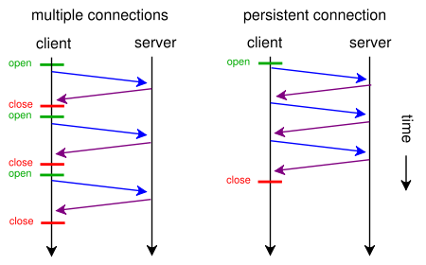
Connections Types

Slide 46
Hands on

Slide 47
Browser Requests and Responses
Start google Chrome.
Press F12 for developers tools.
Browse to www.facebook.com
Watch as the requests the browser is sending to facebook server are flowing in the lower window.
Select the first request and inspect the request and response headers.

Slide 48
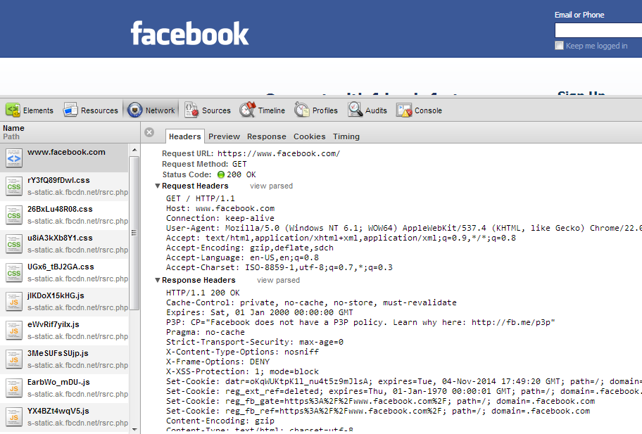

Slide 49
HTTP Client
Let’s create something like a browser.
Multithreaded.
Create a console application “HTTPClient”.
Add HTTPRequest Class.

Slide 50
In program.cs
static void Main(string[] args)
{
string[] websites = new string[]
{ "www.google.com",
"www.facebook.com",
"www.yahoo.com" };
foreach (string website in websites)
{
Thread thread = new Thread(new ParameterizedThreadStart(HTTPRequest.HandleRequest));
thread.Start(website);
}
//To keep the app alive until all threads have finished.
Console.ReadLine();
}

Slide 51
HTTPRequest (1)
public static void HandleRequest(object obj)
{
string website = (string)obj;
IPAddress[] addresses;
try
{
//Gets list of IP addresses bound to that domain.
addresses = Dns.GetHostAddresses(website);
if (addresses.Length == 0)
{
Console.WriteLine("Error: {0}", website);
return;
}
}
catch(Exception ex)
{
Console.WriteLine(ex.Message);
return;
}

Slide 52
HTTPRequest (2)
IPAddress host = addresses[0];
int hostPort = 80;
IPEndPoint hostep = new IPEndPoint(host, hostPort);
Socket socket = new Socket(AddressFamily.InterNetwork, SocketType.Stream, ProtocolType.Tcp);
socket.Connect(hostep);

Slide 53
HTTPRequest (3)
string request = "GET / HTTP/1.1\r\n" +
"Host: " + website + "\r\n" +
"User-Agent: Chrome/22.0.1229.94\r\n"
+ "\r\n";
socket.Send(Encoding.ASCII.GetBytes(request));
byte[] dataReceived = new byte[1024 * 1024];
int len = socket.Receive(dataReceived);
string page = Encoding.ASCII.GetString(dataReceived, 0, len);
socket.Close();

Slide 54
HTTPRequest (4)
StreamWriter writer = new StreamWriter(string.Format("{0}.html", website));
writer.WriteLine(page);
writer.Close();
Console.WriteLine("Finished: {0}", website);
}

Slide 55
Output HTTP Responses
Open bin/Debug folder to find the saved HTTP responses.
Facebook response:
Google response:
Because google redirects to google.com.eg
Yahoo response:
Because yahoo redirects to maktoob.yahoo.com
HTTP/1.1 200 OK
HTTP/1.1 302 Found
Location: http://www.google.com.eg/
HTTP/1.1 302 Found
Location: http://maktoob.yahoo.com/?p=us

Slide 56
HTTP Server
Networks Project Description

Slide 57
Delivery guidelines
Number of team members: minimum five and maximum six.
Teams must be from the same department.
Registration form will be available from Saturday 11/12 to Friday 17/12 and will be announced on your group.
You are allowed to register only once, so please make sure before you register that your team mates did not register before.

Slide 58
Delivery guidelines
If you have any exams from last year at the same day of the practical exam, please write it in the comment section of the registration form to consider it in the lab exam timing.
If anyone didn’t register, he/she will be considered to have zero.
If anyone didn’t show up at the delivery time, he/she will be considered to have zero in the project.

Slide 59
Delivery guidelines
Practical exam will be either project modification or small task, so please be ready for both.
Practical exam will include oral questions about Socket Programming.
Practical day timing will be based on teams not sections and it will be announced on group.

Slide 60
Requirements
Implement part of the HTTP protocol.
Threaded (multiple clients)
GET only.
Error handling
Page Not found
Bad Request
Redirection
Internal Server Error

Slide 61
Starting the Server
Accept multiple clients by starting a thread for each accepted connection.
Keep on accepting requests from the remote client until the client closes the socket (sends a zero length message)
For each received request, the server must reply with a response.

Slide 62
Receiving Request
The received request must be a valid HTTP request, else return 400 Bad Request
Check single space separating the request line parameters.
Method URI HTTPVersion
Check blank line separating the header lines and the content, even if the content is empty
Check valid URI
Check at least request line and host header and blank lines exist.

Slide 63
Response Headers
The response should include the following headers:
Content-Type:
We will use only text/html
Content-Length:
The length of the content
Date:
Current DateTime of the server
Location:
Only if there is redirection.

Slide 64
Handling Request
Using Configuration.RootPath, map the URI to the physical path
Example: configuration.RootPath= “c:\intepub\wwwroot\fcis1” and URI = “/aboutus.html” then physical path= “c:\intepub\wwwroot\fcis1\aboutus.html”

Slide 65
Redirection
If the URI exists in the configuration.RedirectionRules, then return 301 Redirection Error and add location header with the new redirected URI.
The content should be the content of the static page “redirect.html”

Slide 66
Not Found
If the physical file is not found return 404 Not Found error.
The content should be the content of the static page “Notfound.html”

Slide 67
Bad Request
If there is any parsing error in the request, return 400 Bad Request Error.
The content should be loaded with the content of the static page “BadRequest.html”

Slide 68
Internal Server Error
If there is any unknown exception, return 500 Internal Server Error.
The content should be the content of the static page “InternalError.html”

Slide 69
Template walkthrough

Slide 70
Server Demo

Slide 71
Project Running
Run the server
Try the following URIs in the web browser: http://localhost:1000/aboutus2.html should display aboutus2.html page http://localhost:1000/aboutus.html should display aboutus2.html (redirection) http://localhost:1000/main.html should display main page http://localhost:1000/blabla.html should display 404 page.

